Slide 1
Exhibit 1: Murders in England and Wales 1967-2002: when rates doubled.
Number per year to left, rate per million on right. Source: Prime Suspect

Slide 2
Exhibit 2: Chances per million per year by age and sex: who is most often murdered
Men to the left, women to the right, rate per million per year. Source: Prime Suspect

Slide 3
Exhibit 3: Changes in murder rate in Britain 1981-1985 to 1996-2000, by age and sex
Men to the left, women to the right, change in 15 year rate. Source: Prime Suspect

Slide 4
Exhibit 4: Polarisation by area by poverty over time: changes at the extremes
National murder rate: 100. Comparison of extreme deciles. Source: Prime Suspect

Slide 5
Exhibit 5: Method of killing by area poverty rate 1981-2000: how murders are committed
All murders for which method recorded shown as proportion. Source: Prime Suspect

Slide 6
Exhibit 6: murder rates per million men in Britain by age/cohort (post 1965/1980)
Year | 1993 | 1994 | 1995 | 1996 | 1997 | 1998 | 1999 | 2000
Age
11 | 1 | 1 | 3 | 3 | 2 | 1 | 1 | 3
12 | 1 | 2 | 4 | 5 | 3 | 2 | 3 | 5
13 | 2 | 3 | 6 | 6 | 4 | 3 | 4 | 6
14 | 5 | 5 | 6 | 7 | 6 | 4 | 5 | 7
15 | 7 | 8 | 11 | 12 | 10 | 9 | 11 | 11
16 | 13 | 13 | 17 | 19 | 17 | 17 | 19 | 17
17 | 21 | 21 | 23 | 24 | 25 | 26 | 27 | 26
18 | 24 | 24 | 27 | 28 | 28 | 31 | 35 | 35
19 | 24 | 25 | 30 | 31 | 28 | 30 | 37 | 42
20 | 26 | 29 | 32 | 33 | 30 | 32 | 41 | 49
21 | 31 | 33 | 34 | 34 | 35 | 36 | 42 | 51
22 | 32 | 34 | 34 | 32 | 33 | 32 | 34 | 42
23 | 29 | 31 | 33 | 31 | 27 | 27 | 30 | 34
24 | 26 | 29 | 33 | 33 | 29 | 27 | 30 | 33
25 | 28 | 30 | 33 | 34 | 31 | 27 | 27 | 30
26 | 27 | 29 | 31 | 30 | 28 | 26 | 29 | 31
27 | 21 | 23 | 27 | 27 | 24 | 25 | 33 | 36
28 | 20 | 21 | 26 | 24 | 21 | 26 | 35 | 38
29 | 23 | 23 | 23 | 20 | 23 | 30 | 36 | 37
30 | 24 | 25 | 24 | 24 | 26 | 30 | 30 | 31
31 | 23 | 24 | 26 | 27 | 27 | 26 | 27 | 30
32 | 24 | 25 | 25 | 24 | 25 | 27 | 29 | 31
33 | 24 | 28 | 25 | 21 | 23 | 27 | 30 | 32
34 | 22 | 27 | 26 | 22 | 21 | 24 | 31 | 39
35 | 19 | 25 | 27 | 21 | 17 | 22 | 30 | 36
36 | 20 | 27 | 29 | 22 | 18 | 21 | 25 | 26
37 | 21 | 26 | 28 | 23 | 20 | 19 | 21 | 24
38 | 20 | 23 | 26 | 25 | 21 | 18 | 21 | 25
39 | 20 | 23 | 26 | 26 | 23 | 22 | 24 | 25
40 | 22 | 23 | 24 | 25 | 25 | 25 | 25 | 24
41 | 24 | 22 | 22 | 23 | 26 | 25 | 23 | 24
42 | 22 | 22 | 21 | 21 | 24 | 23 | 22 | 27
43 | 17 | 20 | 19 | 17 | 19 | 22 | 23 | 25
44 | 15 | 18 | 19 | 16 | 18 | 23 | 22 | 18
45 | 15 | 19 | 20 | 19 | 19 | 21 | 18 | 13
46 | 16 | 18 | 19 | 19 | 18 | 17 | 15 | 15
47 | 15 | 17 | 17 | 16 | 15 | 16 | 18 | 18
48 | 13 | 15 | 16 | 14 | 16 | 20 | 21 | 19
49 | 14 | 16 | 15 | 14 | 17 | 21 | 22 | 20
50 | 17 | 18 | 15 | 14 | 16 | 17 | 17 | 18
Smoothed rates shown. Diagonal is the 1965 cohort. Source: Prime Suspect

Slide 7
Exhibit 7: gun crime is minor, but that is
Not the impression you gain from this:

Slide 8
Exhibit 8
Source: www.shef.ac.uk/sasi/socr

Slide 9
Exhibit 9
Source: www.shef.ac.uk/sasi/socr

Slide 10
Exhibit 10
Source: www.shef.ac.uk/sasi/socr

Slide 11
Exhibit 11
Source: www.shef.ac.uk/sasi/socr

Slide 12
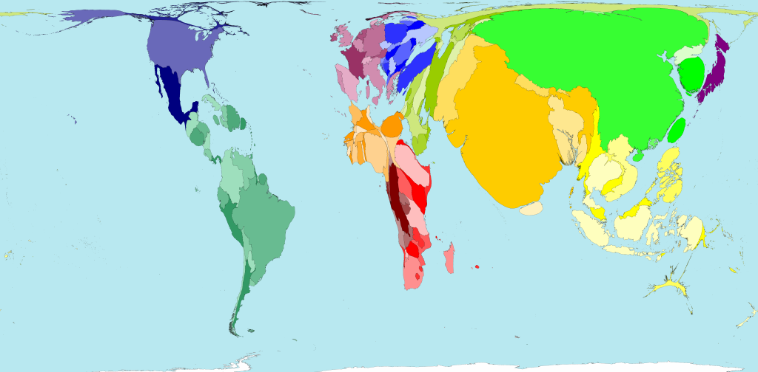
Exhibit 12: Road deaths (1m)
Source: www.worldmapper.org

Slide 13

Exhibit 13: Are bank charges legal?
7 June 2006
ROBBER BANKS
Customers hit for £4.7bn a year in penalty charges for straying into red
For more details see http://www.thisismoney.co.uk
From where the following template was borrowed:
Source: www.mirror.co.uk/mirrormoney/

Slide 14
Exhibit 14: One suggested template:
Dear Sir/Madam,
Ref: account number: (your account number)
I understand that the charges applied to my account in relation to the following (enter details of what charges were for) are unlawful.
When I opened my account I entered into a contract with you, at which time you agreed to act lawfully. The fees you have been applying to my account in relation to the above are unlawful under Common Law, Statute and consumer regulations.
You have taken (enter charges amount here) from me, plus the following in (enter overdraft interest amount here) overdraft interest and I would like to request repayment of this (enter total sum) total sum. I also ask you to ensure any default notices entered against my credit record are removed entirely.
Please repay this money in full and remove any default notices within 14 days. If this is not done, I will begin a claim against you for the full amount, plus interest and my costs.
Yours sincerely,
Source: http://www.thisismoney.co.uk

Slide 15
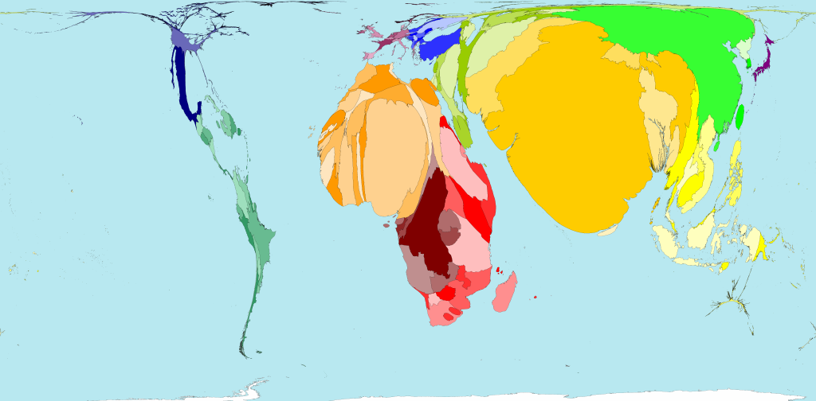
Exhibit 15: Stillbirths (3.3m)
Source: www.worldmapper.org

Slide 16
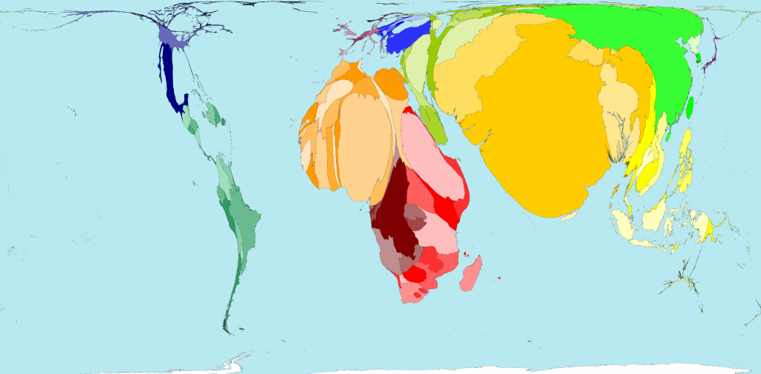
Exhibit 16: Mortality within seven days (3m)
Source: www.worldmapper.org

Slide 17
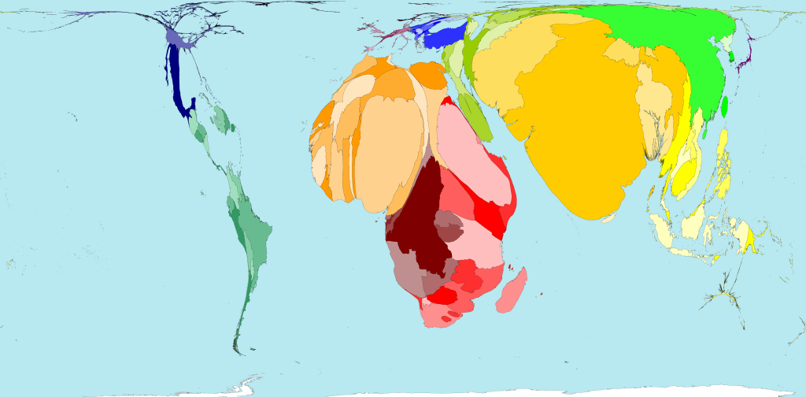
Exhibit 17: Infant mortality (7.2m)
Source: www.worldmapper.org

Slide 18
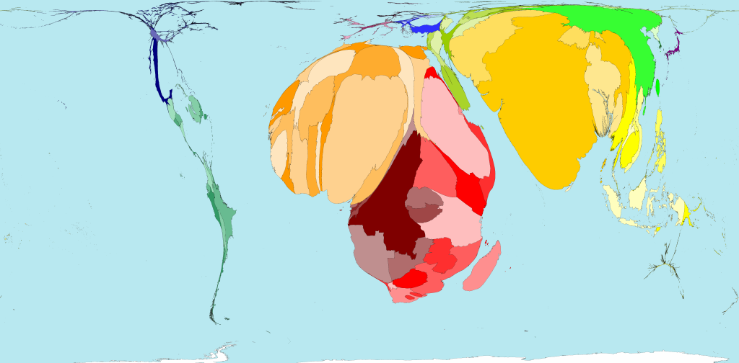
Exhibit 18: Mortality at ages 1 to 4 (3.2m)
Source: www.worldmapper.org

Slide 19
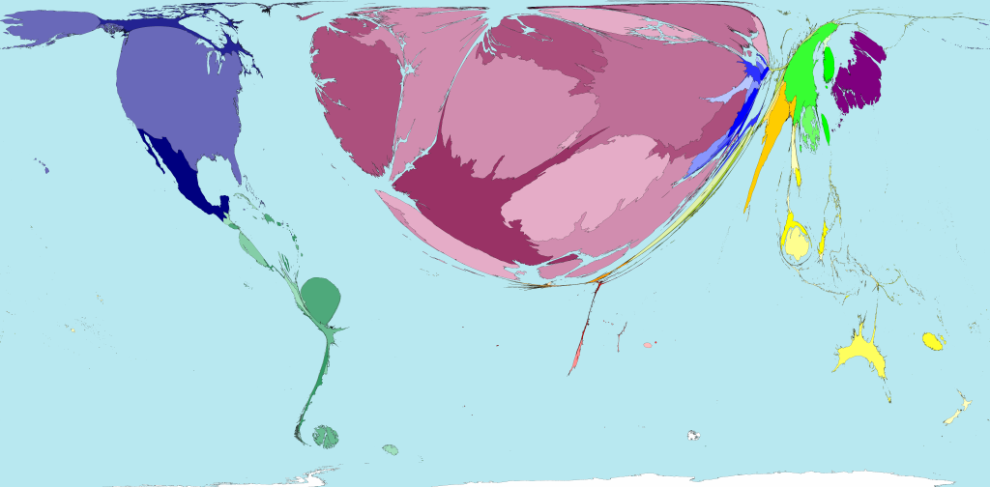
Exhibit 19: Medicines Exports (gross, net $46bn)
Source: www.worldmapper.org

Slide 20
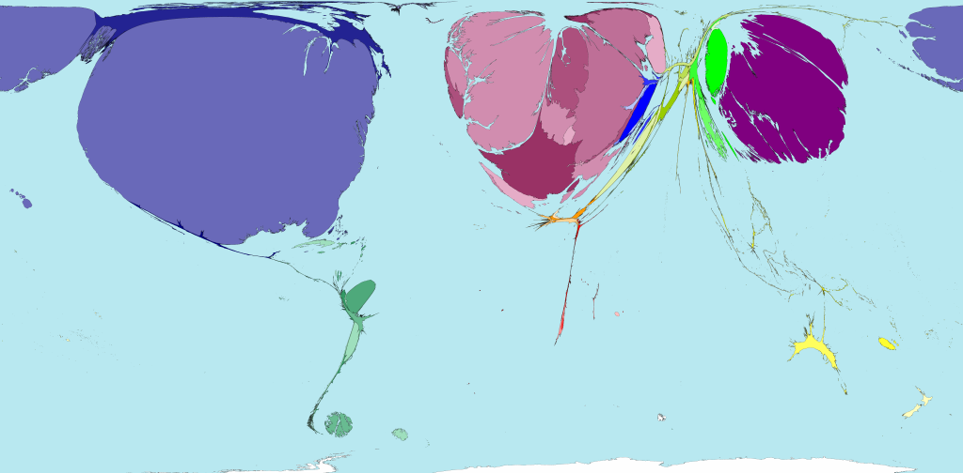
Exhibit 20: Royalties and licence fees – gross exports (2002, $84bn per year)
Source: www.worldmapper.org

Slide 21
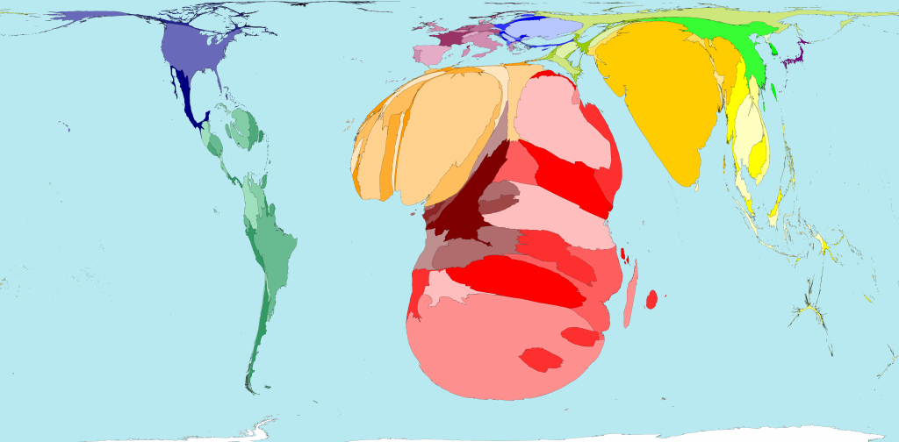
Exhibit 21:More than 25 million people have died of AIDS since it was first diagnosed in the early 1980s; almost 3 million of these deaths occurred in 2005.
Source: www.worldmapper.org

